Slide 1

NNBA experiment summary
Speaker: Chung-Kyun Han
2014.02.28

Slide 2
Contents
Parameter
Empty Travel
Average
Maximum
Customer Waiting Time
Average
Median
Max
Boarding Waiting Time
Average
Maximum

Slide 3
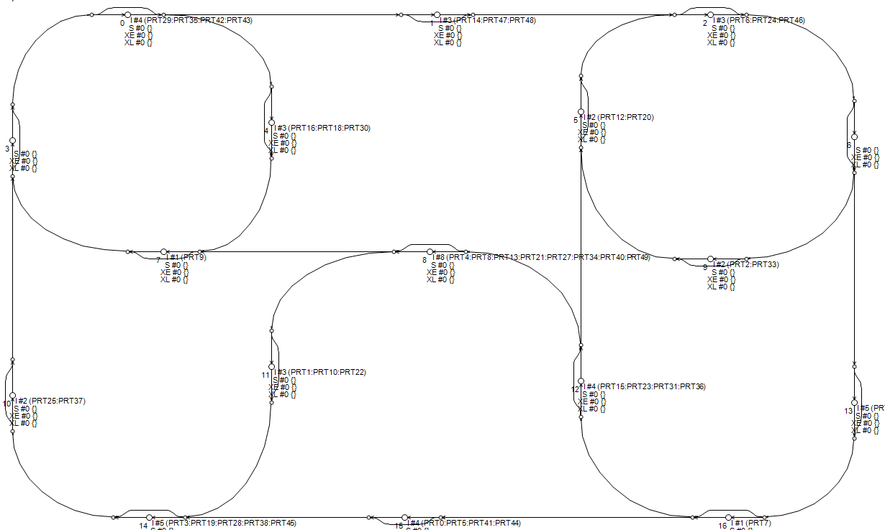
Parameter
S2J_SPEED | 6 (m/s)
J2D_SPEED | 9 (m/s)
PRT_SPEED | 12 (m/s)
PRTs | 50 (대)
J2D_SPEED | 2000 (명)
PRT_SPEED | 4 (개) (Transfer, 5개)
M.A.T | 4.0~6.9 (초)

Slide 4
Empty Travel
Average

Slide 5
Empty Travel
Maximum

Slide 6
Customer Waiting Time
Average

Slide 7
Customer Waiting Time
Median

Slide 8
Customer Waiting Time
Maximum

Slide 9
Boarding Waiting Time
Average

Slide 10
Boarding Waiting Time
Maximum

